Slide 1
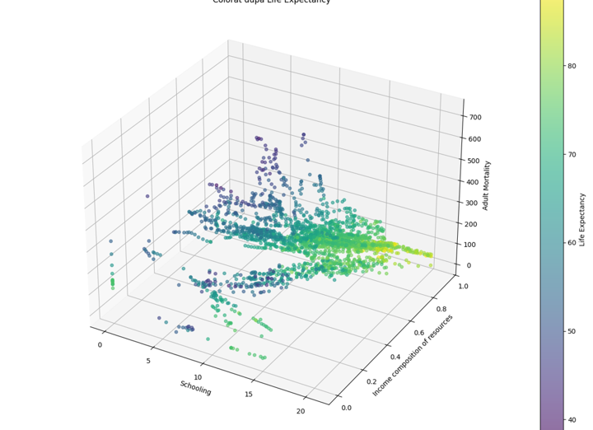
Analiza Sperantei de Viata
Modele de Predictie
Business Logic si Rezultate

Slide 2
Business Logic
Obiectiv: Predictia indicatorului 'Life Expectancy' la nivel global.
Utilitate: Sprijinirea politicilor de sanatate publica prin identificarea factorilor de risc.
Metodologie: Analiza predictiva pe date istorice (serii anuale, 2000-2015)
-clustering
-modele Keras MLP, XBOOST cu si fara random ssearch
-functii: leakyrelu vs relu
Factori urmariti: Mortalitate, Vaccinare, Indicatori Economici (PIB), Educatie.

Slide 3
Curatarea si Pregatirea Datelor
Randuri initiale: 2938
Randuri eliminate: 330 (tari cu date lipsa critice).
Split Temporal: Train (2000-2009), Validare (2010-2011), Test (2012-2015).
Imputare: Media pe setul de antrenament (evitarea data leakage).

Slide 4
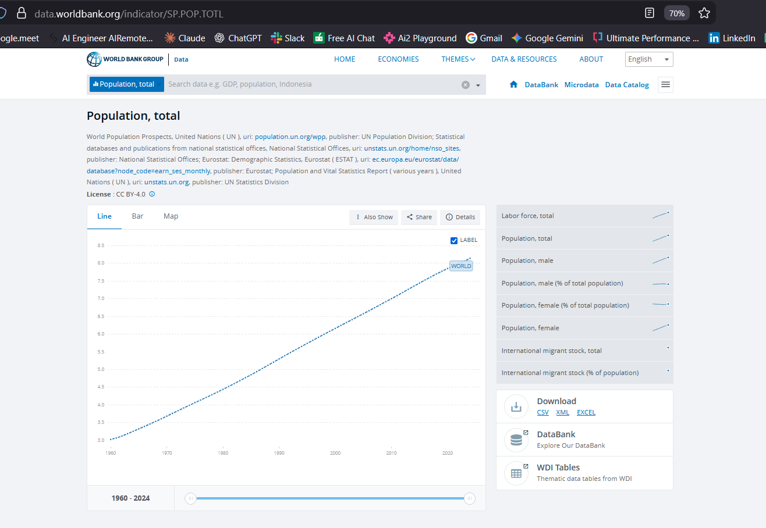
Curatarea si Pregatirea Datelor
Corectatarea si completare Coloane [GDP], [Population]

Slide 5
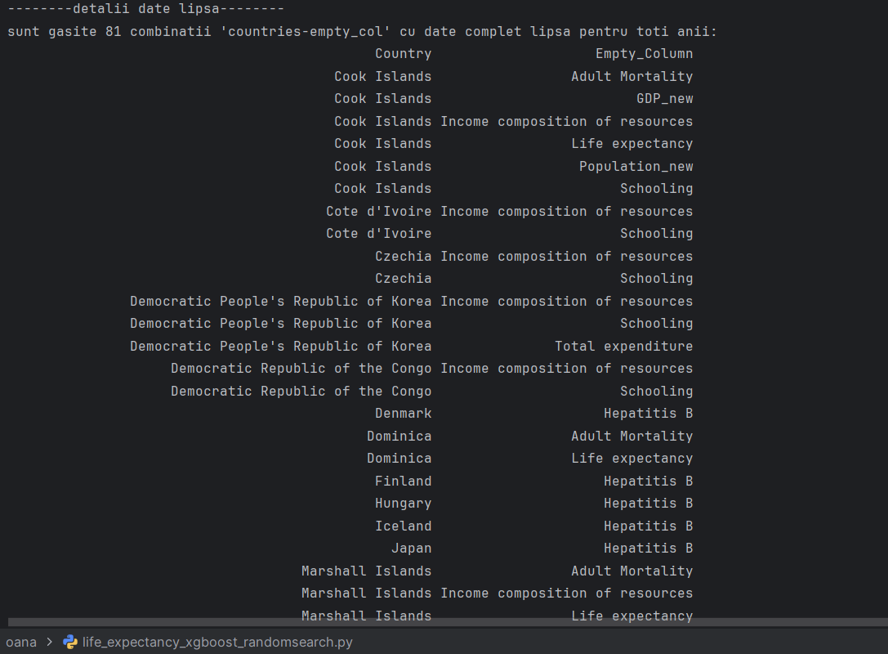
Modelul XGBoost si Random Search
Algoritm: XGBoost (Gradient Boosting nativ).
Optimizare: Random Search (30 combinatii de parametri).
Early Stopping: Prevenirea overfitting-ului (50 runde).
Hiperparametri: Learning rate (eta), Adâncime (max_depth), Subsample, Regularizare (Alpha/Lambda).

Slide 6
Curatarea si Pregatirea Datelor
-----countries unice afectate -----------
Numar countries afectate: 30
- Cook Islands
- Cote d'Ivoire
- Czechia
- Democratic People's Republic of Korea
- Democratic Republic of the Congo
- Denmark
- Dominica
- Finland
- Hungary
- Iceland
- Japan
- Marshall Islands
- Monaco
- Nauru
- Niue
- Norway
- Palau
- Republic of Korea
- Republic of Moldova
- Saint Kitts and Nevis
- San Marino
- Slovenia
- Somalia
- South Sudan
- Sudan
- Switzerland
- Tuvalu
- United Kingdom of Great Britain and Northern Ireland
- United Republic of Tanzania
- United States of America

Slide 7
Curatarea si Pregatirea Datelor
-------------data cleaned info()---------------
<class 'pandas.core.frame.DataFrame'>
Index: 2608 entries, 0 to 2937
Data columns (total 22 columns):
# Column Non-Null Count Dtype
--- ------ -------------- -----
0 Country 2608 non-null object
1 Year 2608 non-null int64
2 Status 2608 non-null object
3 Life expectancy 2608 non-null float64
4 Adult Mortality 2608 non-null float64
5 infant deaths 2608 non-null int64
6 Alcohol 2448 non-null float64
7 percentage expenditure 2608 non-null float64
8 Hepatitis B 2247 non-null float64
9 Measles 2608 non-null int64
10 BMI 2608 non-null float64
11 under-five deaths 2608 non-null int64
12 Polio 2600 non-null float64
13 Total expenditure 2444 non-null float64
14 Diphtheria 2600 non-null float64
15 HIV/AIDS 2608 non-null float64
16 GDP_new 2608 non-null float64
17 Population_new 2608 non-null float64
18 thinness 1-19 years 2608 non-null float64
19 thinness 5-9 years 2608 non-null float64
20 Income composition of resources 2608 non-null float64
21 Schooling 2608 non-null float64
dtypes: float64(16), int64(4), object(2)
memory usage: 468.6+ K

Slide 8
Curatarea si Pregatirea Datelor
---------rezultate curatare data frame---------
-numar initial de randuri: 2938
-numar randuri sterse: 330
-numar de randuri ramase: 2608
-numar initial de countries: 193
-numar countries sterse: 30
-numar countries unice ramase: 163
---------coloane ramase cu randuri nule dupa curatare data frame---------
Alcohol 160
Hepatitis B 361
Polio 8
Total expenditure 164
Diphtheria 8
dtype: int64

Slide 9
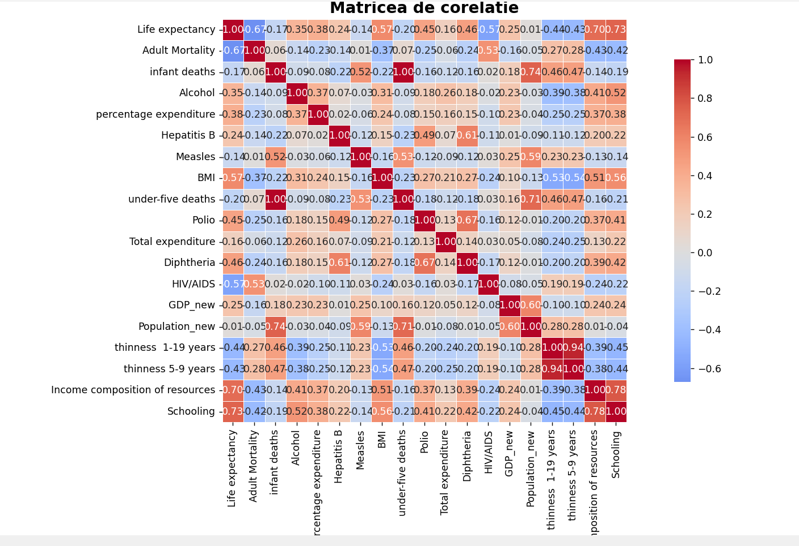
Analiza Datelor

Slide 10
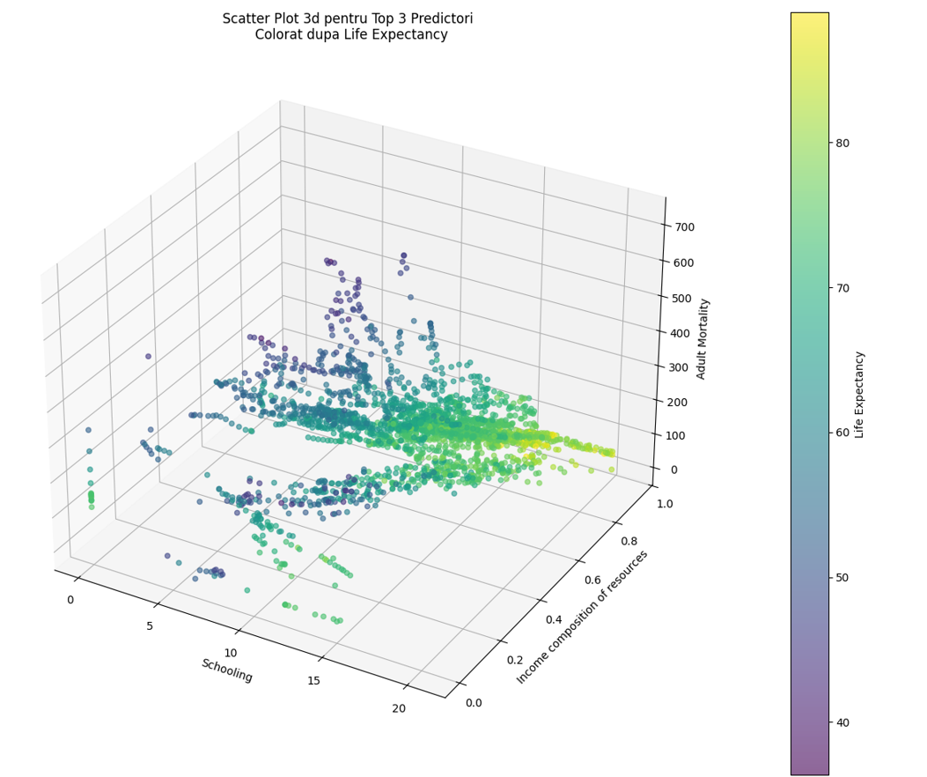
Analiza Datelor

Slide 11
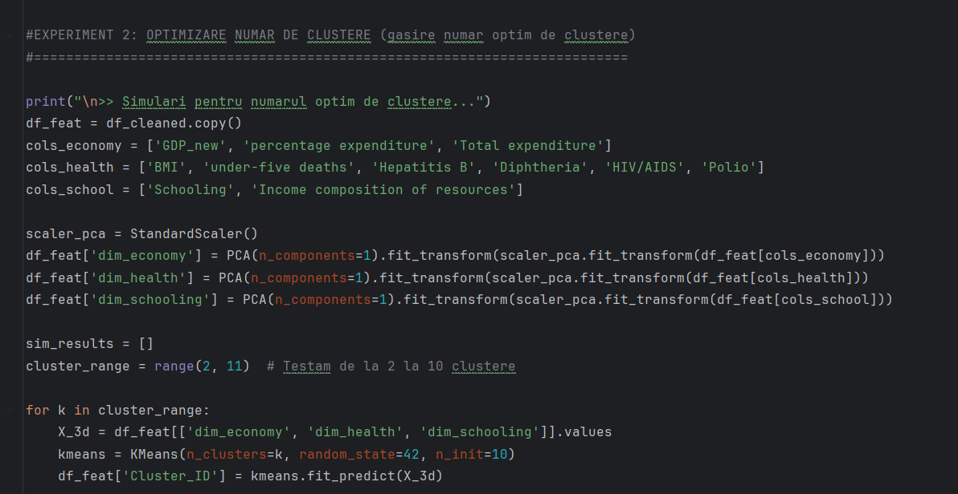
Clustering
Clustering > scop
- Optimizarea numarului de clustere utilizare in cadrul modelului, pentru a imbunatati performata predictiilor

Slide 12
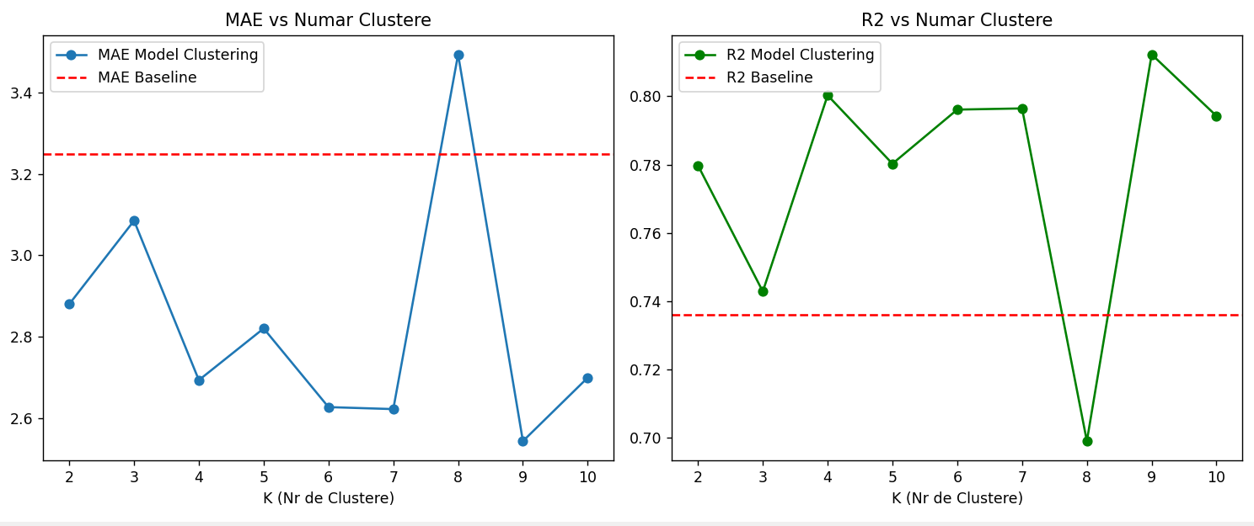
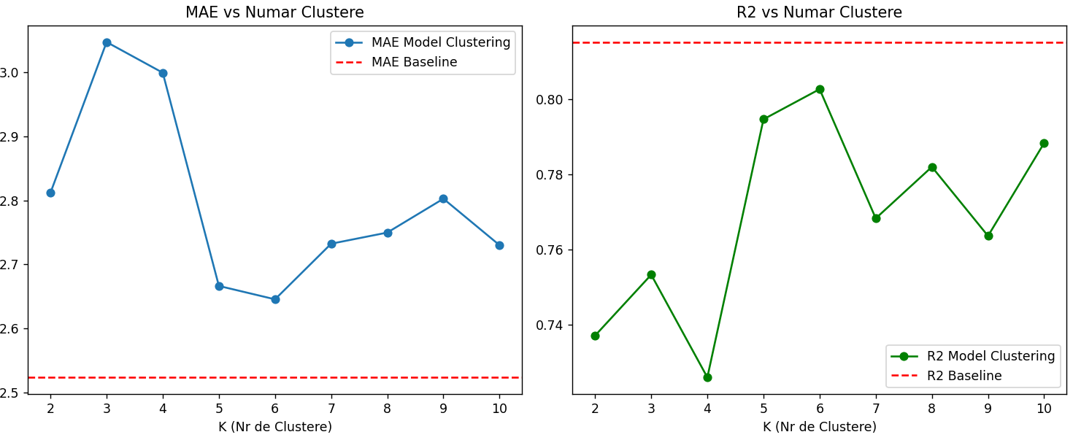
Clustering

Slide 13
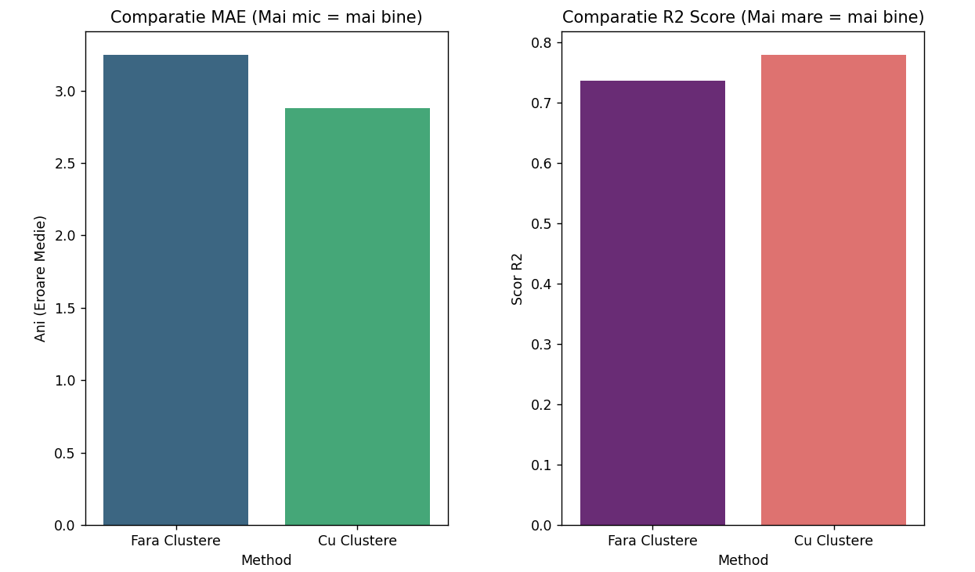

Slide 14
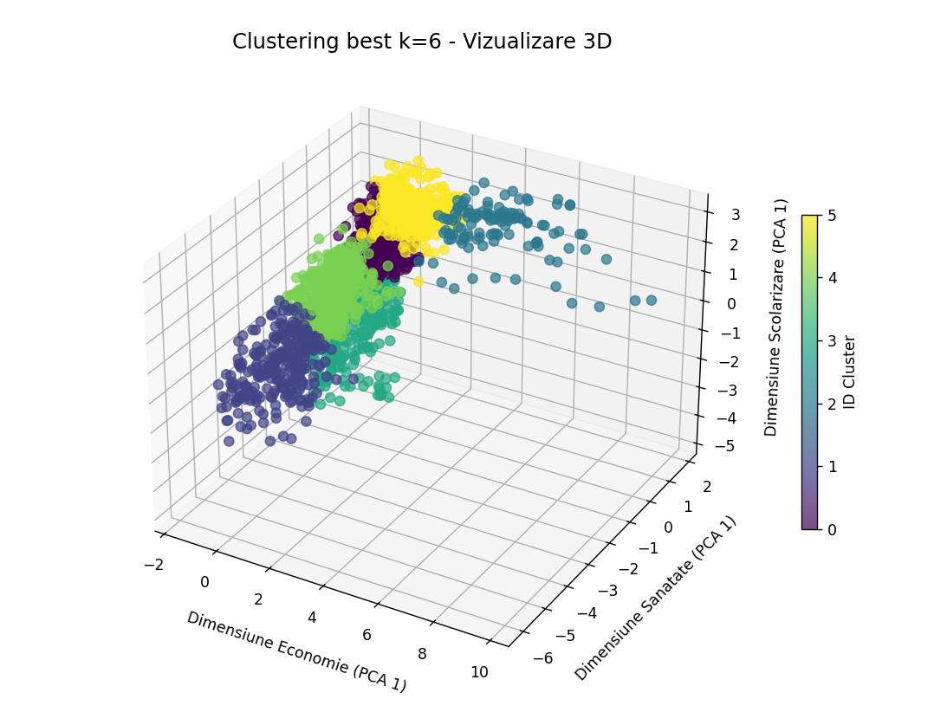
Clustering

Slide 15
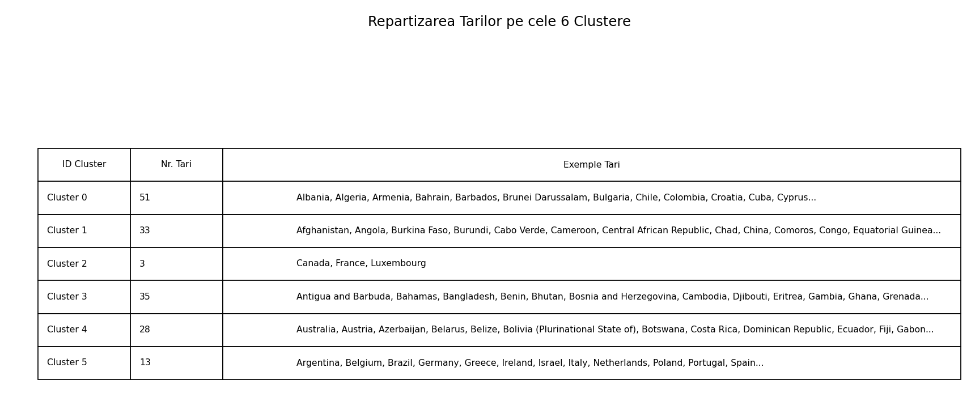
Clustering

Slide 16
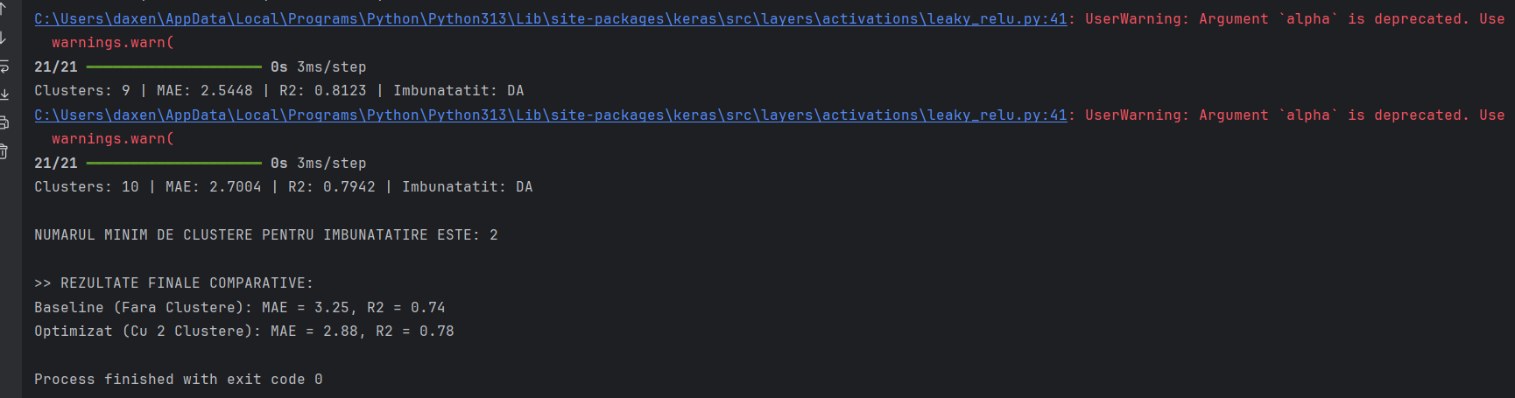
Clustering

Slide 17
Clustering
Concluzii
Utilizarea clusteringului duce de fiecare data la o performata mai scazuta, datorita overfittingului
China = outlier masiv pe variabilele "scale-sensitive" - valorile foarte mari ale life expectancy pentru China apar dintr-o combinatie de efecte structurale din date si model: Population extrem de mare, GDP total foarte mare, valori mari/atipice la Measles, under-five deaths, BMI, etc.; cu utilizarea `StandardScaler`, problema ramane; fix:
log1p pe:
Population
GDP
Measles
under-five deaths
sau RobustScaler in loc de StandardScaler
Sau atributul ‘Country’ embedded
Sau utilizarea XGBOOST (XGBoost „inchide" China intr-o zona sigura a datasetului, MLP incearca sa extrapoleze continuu si explodeaza)

Slide 18
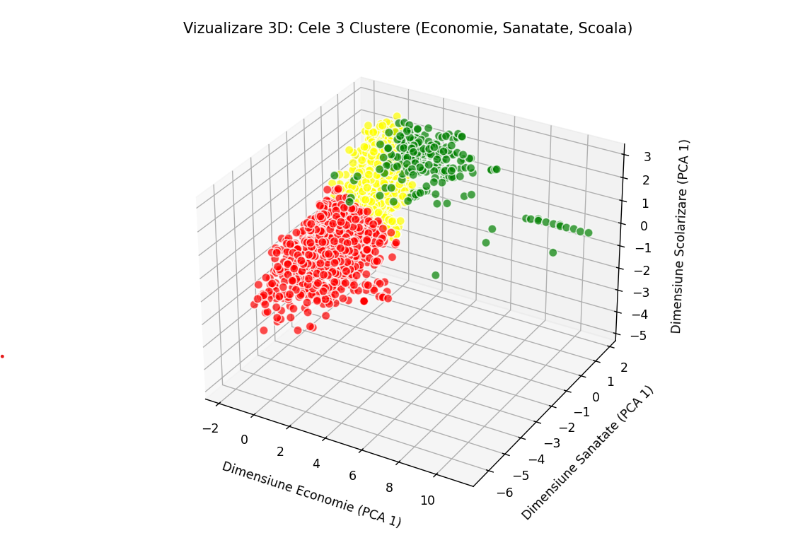
Clustering
Economie= ['GDP', 'percentage expenditure', 'Total expenditure’] Sanatate = ['BMI', 'under-five deaths', 'Hepatitis B', 'Diphtheria', 'HIV/AIDS', 'Polio’] Scolarizare= ['Schooling', 'Income composition of resources']

Slide 19
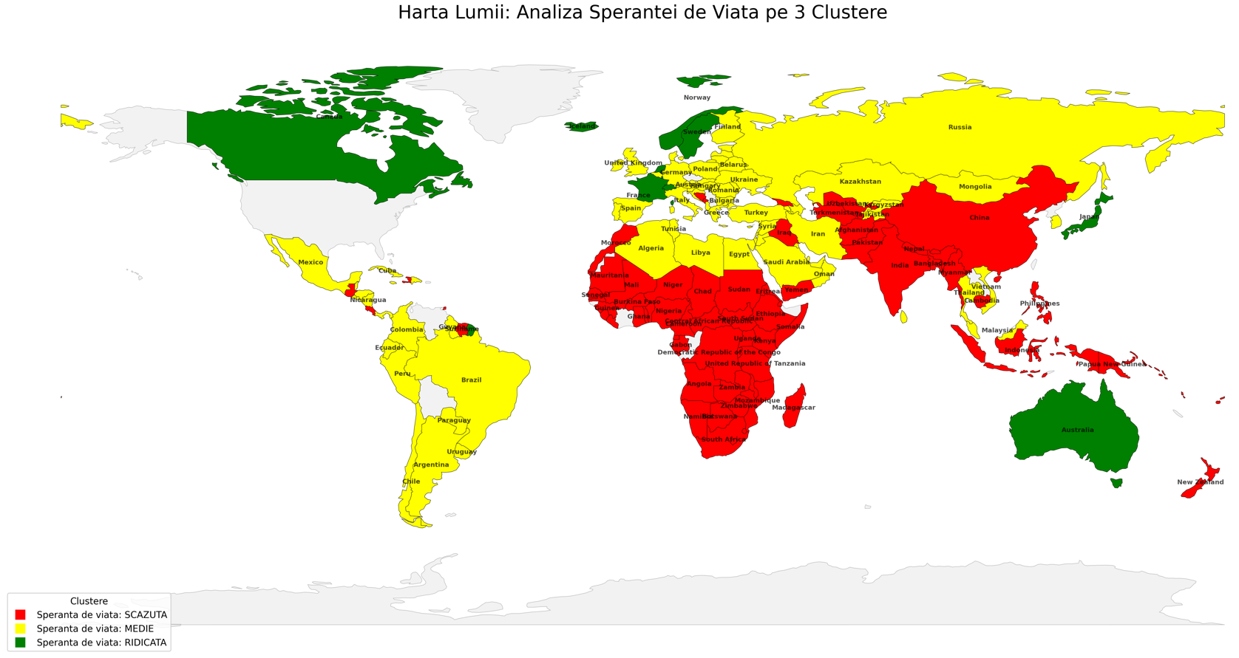
Clustering

Slide 20
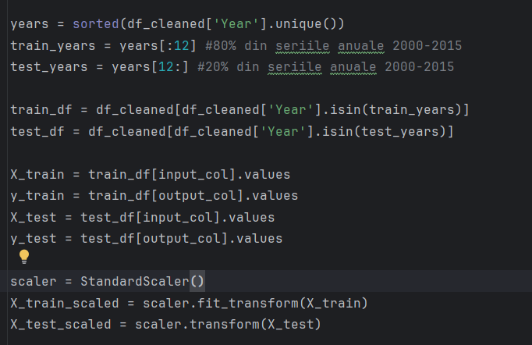
B. X_train vs X_test

Slide 21
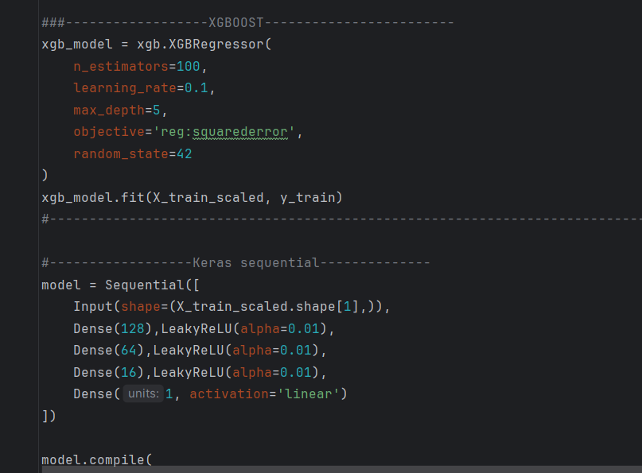
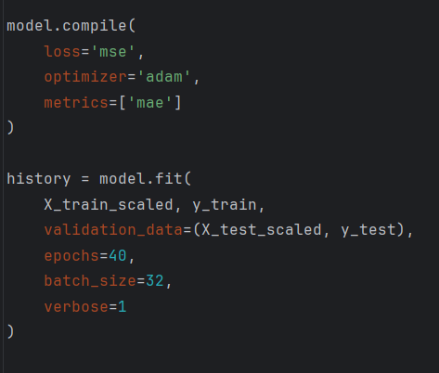
B. XGBoost vs Keras MLP

Slide 22
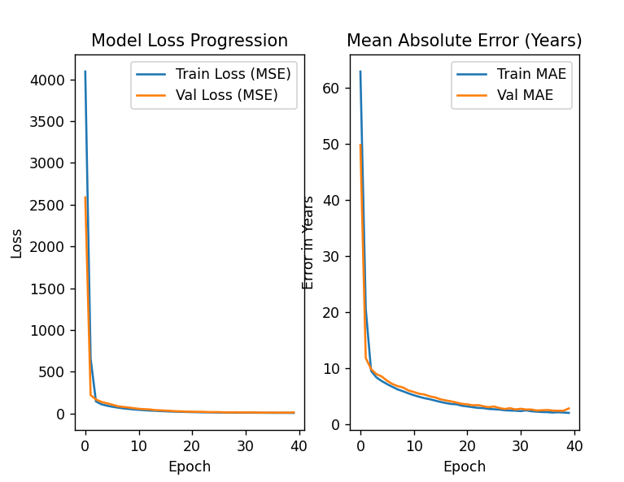
B. XGBoost vs Keras MLP

Slide 23
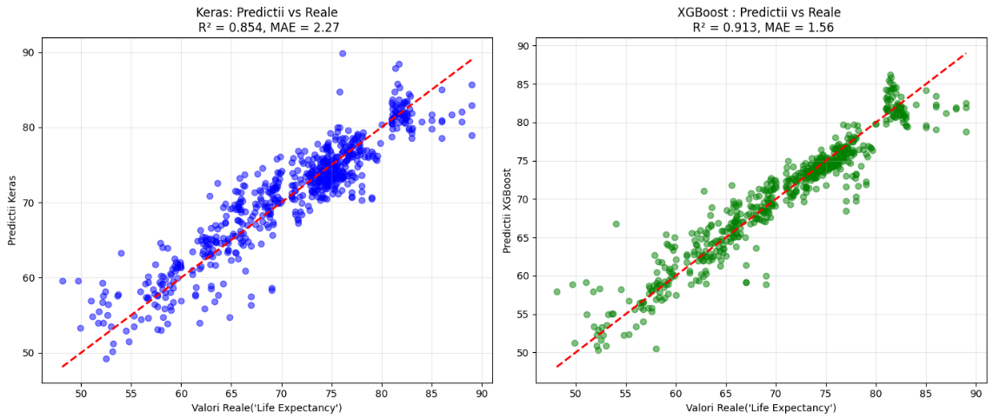
XGBoost vs Keras MLP
Keras vs XGBoost valorii reale si predictii

Slide 24
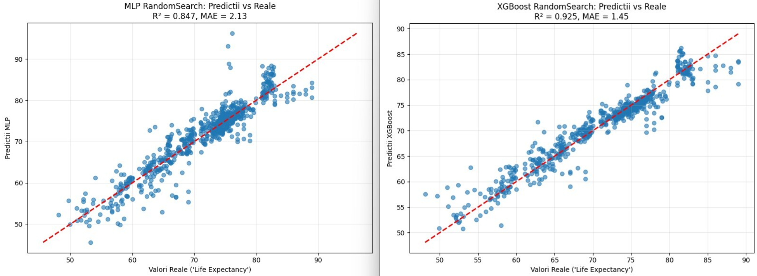
XGBoost vs Keras MLP

Slide 25
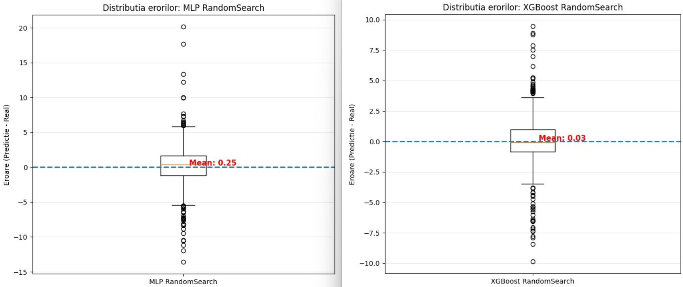
XGBoost vs Keras MLP

Slide 26
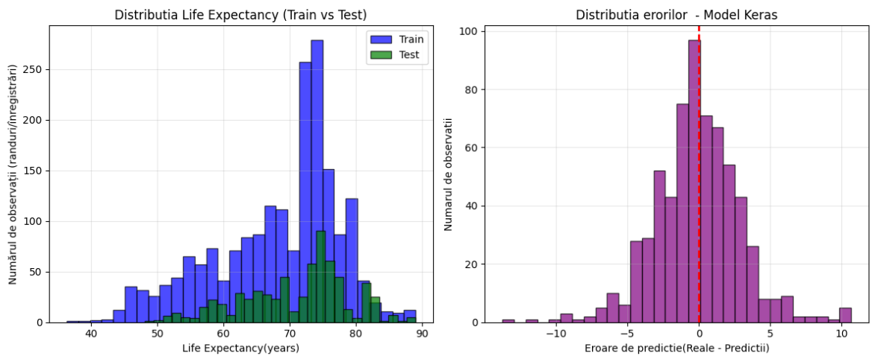
XGBoost vs Keras MLP

Slide 27
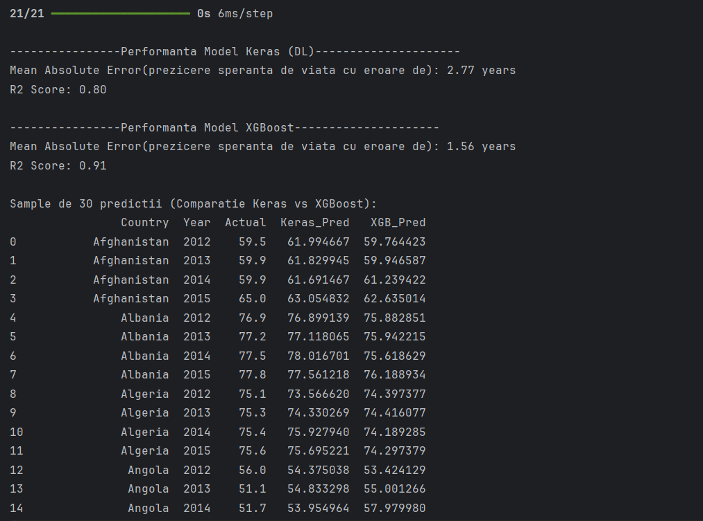
B. XGBoost vs Keras MLP

Slide 28
B. XGBoost vs Keras MLP
Sample de 30 predictii (Comparatie Keras vs XGBoost):
 | Country | Year | Actual | Keras_Pred | XGB_Pred
 | Afghanistan | 2012 | 59.5 | 61.994667 | 59.764423
 | Afghanistan | 2013 | 59.9 | 61.829945 | 59.946587
 | Afghanistan | 2014 | 59.9 | 61.691467 | 61.239422
 | Afghanistan | 2015 | 65 | 63.054832 | 62.635014
 | Albania | 2012 | 76.9 | 76.899139 | 75.882851
 | Albania | 2013 | 77.2 | 77.118065 | 75.942215
 | Albania | 2014 | 77.5 | 78.016701 | 75.618629
 | Albania | 2015 | 77.8 | 77.561218 | 76.188934
 | Algeria | 2012 | 75.1 | 73.56662 | 74.397377
 | Algeria | 2013 | 75.3 | 74.330269 | 74.416077
 | Algeria | 2014 | 75.4 | 75.92794 | 74.189285
 | Algeria | 2015 | 75.6 | 75.695221 | 74.297379
 | Angola | 2012 | 56 | 54.375038 | 53.424129
 | Angola | 2013 | 51.1 | 54.833298 | 55.001266
 | Angola | 2014 | 51.7 | 53.954964 | 57.97998
 | Angola | 2015 | 52.4 | 58.451073 | 58.300034
 | Antigua | 2012 | 75.9 | 74.834038 | 74.357819
 | Antigua | 2013 | 76.1 | 74.928879 | 74.497604
 | Antigua | 2014 | 76.2 | 75.087875 | 74.240723
 | Antigua | 2015 | 76.4 | 77.169426 | 73.973434
 | Argentina | 2012 | 75.9 | 79.943733 | 78.022484
 | Argentina | 2013 | 76 | 78.192574 | 76.647156
 | Argentina | 2014 | 76.2 | 78.29039 | 76.60495
 | Argentina | 2015 | 76.3 | 80.047623 | 77.178337
 | Armenia | 2012 | 74.4 | 75.63356 | 74.92614
 | Armenia | 2013 | 74.4 | 75.747032 | 74.811165
 | Armenia | 2014 | 74.6 | 76.925453 | 74.124008
 | Armenia | 2015 | 74.8 | 76.835487 | 74.940231
 | Australia | 2012 | 82.3 | 84.38591 | 81.844734
 | Australia | 2013 | 82.5 | 84.575218 | 81.844734

Slide 29
B. Modelul XGBoost si Random Search
Algoritm: XGBoost (Gradient Boosting nativ).
Optimizare: Random Search (30 combinatii de parametri).
Early Stopping: Prevenirea overfitting-ului (50 runde).
Hiperparametri: Learning rate (eta), Adancime (max_depth), Subsample, Regularizare (Alpha/Lambda).

Slide 30
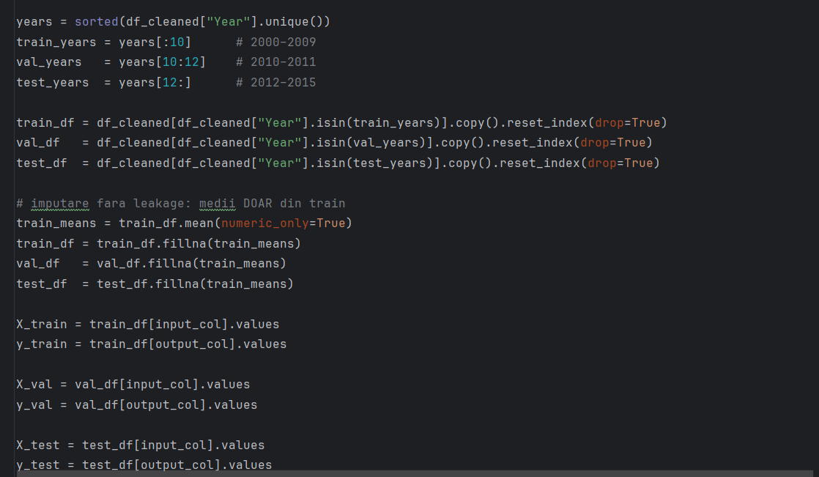
Modelul XGBoost si Random Search

Slide 31
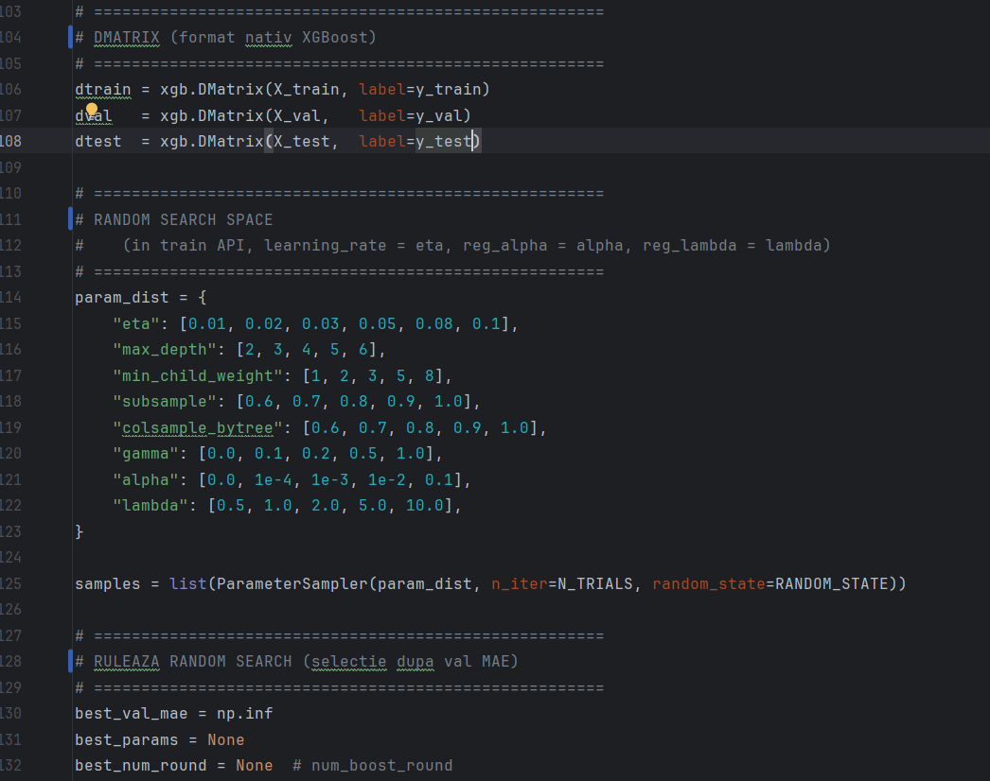
Modelul XGBoost si Random Search

Slide 32
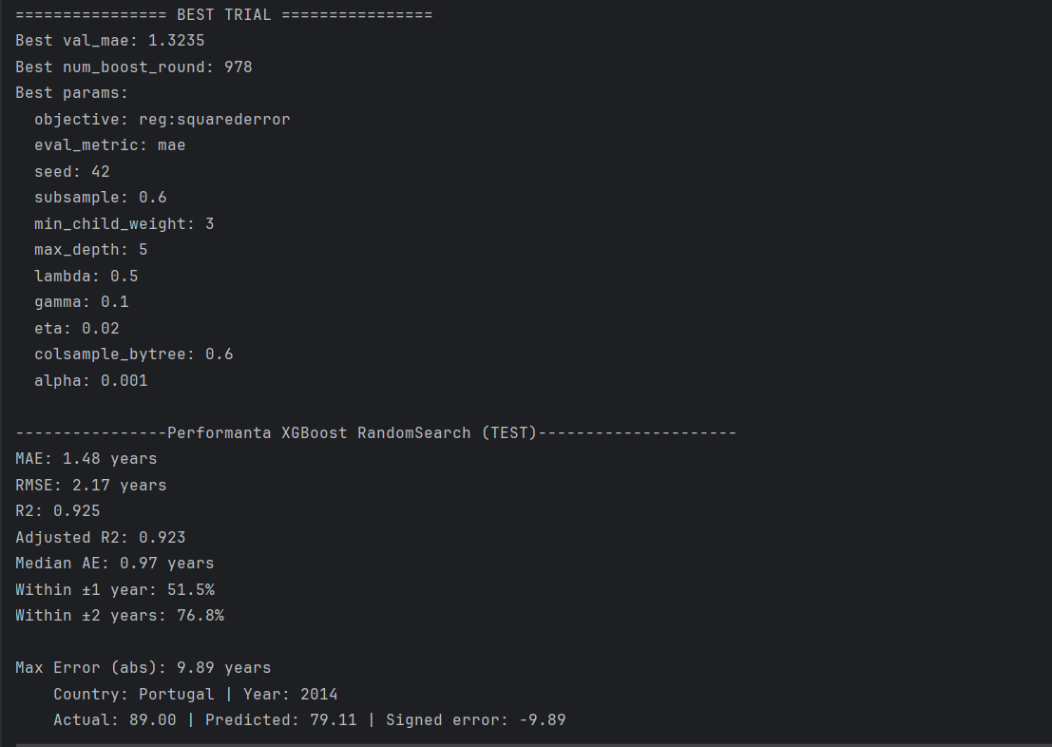
Modelul XGBoost si Random Search

Slide 33
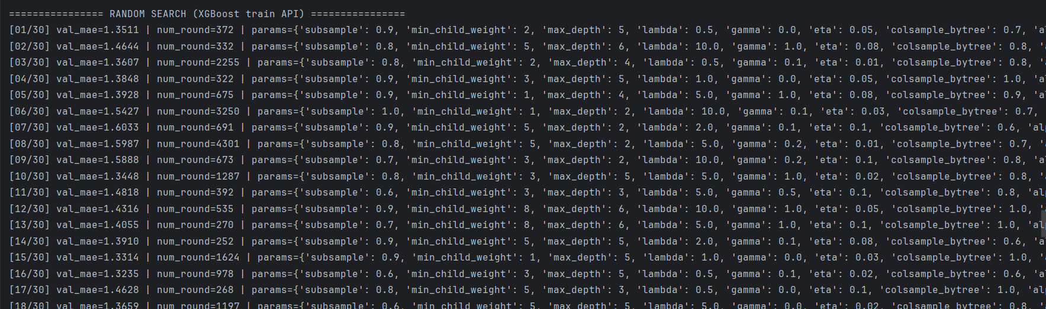
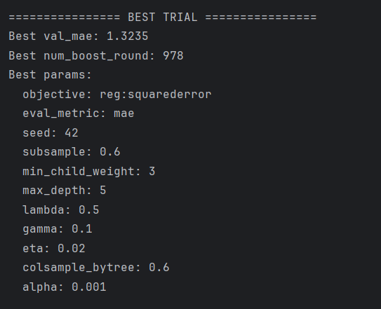
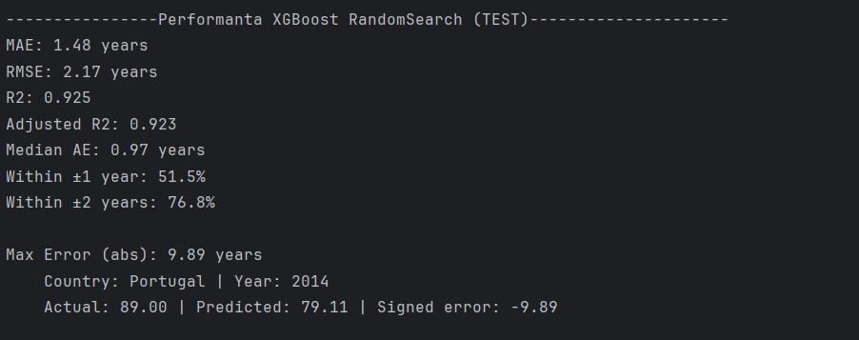
Modelul XGBoost si Random Search

Slide 34
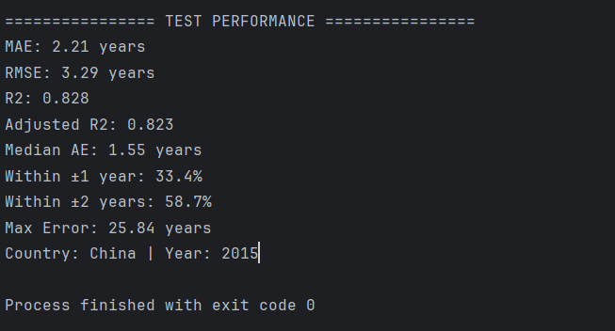
Keras MLP ReLU si Random search

Slide 35
Modelul XGBoost si Random Search
Sample de 30 predictii:
Country | Year | Actual | Predicted | Error | AbsError
Afghanistan | 2012 | 59.5 | 60.261 | 0.760517 | 0.760517
Afghanistan | 2013 | 59.9 | 60.632 | 0.732298 | 0.732298
Afghanistan | 2014 | 59.9 | 60.47 | 0.569597 | 0.569597
Afghanistan | 2015 | 65 | 62.076 | -2.924145 | 2.924145
Albania | 2012 | 76.9 | 75.659 | -1.241164 | 1.241164
Albania | 2013 | 77.2 | 75.785 | -1.415195 | 1.415195
Albania | 2014 | 77.5 | 76.08 | -1.419853 | 1.419853
Albania | 2015 | 77.8 | 76.761 | -1.038693 | 1.038693
Algeria | 2012 | 75.1 | 74.337 | -0.763445 | 0.763445
Algeria | 2013 | 75.3 | 74.339 | -0.960515 | 0.960515
Algeria | 2014 | 75.4 | 74.152 | -1.248228 | 1.248228
Algeria | 2015 | 75.6 | 73.966 | -1.63421 | 1.63421
Angola | 2012 | 56 | 53.899 | -2.101494 | 2.101494
Angola | 2013 | 51.1 | 55.801 | 4.701113 | 4.701113
Angola | 2014 | 51.7 | 57.204 | 5.503899 | 5.503899
Angola | 2015 | 52.4 | 58.624 | 6.223989 | 6.223989
Antigua | 2012 | 75.9 | 74.878 | -1.021964 | 1.021964
Antigua | 2013 | 76.1 | 75.061 | -1.03927 | 1.03927
Antigua | 2014 | 76.2 | 74.836 | -1.364429 | 1.364429
Antigua | 2015 | 76.4 | 74.293 | -2.10665 | 2.10665
Argentina | 2012 | 75.9 | 76.679 | 0.779344 | 0.779344
Argentina | 2013 | 76 | 76.928 | 0.928093 | 0.928093
Argentina | 2014 | 76.2 | 76.788 | 0.58775 | 0.58775
Argentina | 2015 | 76.3 | 77.116 | 0.81631 | 0.81631
Armenia | 2012 | 74.4 | 74.756 | 0.355684 | 0.355684
Armenia | 2013 | 74.4 | 74.715 | 0.314928 | 0.314928
Armenia | 2014 | 74.6 | 74.509 | -0.09099 | 0.09099
Armenia | 2015 | 74.8 | 74.843 | 0.043376 | 0.043376
Australia | 2012 | 82.3 | 81.935 | -0.365147 | 0.365147
Australia | 2013 | 82.5 | 82.254 | -0.245514 | 0.245514

Slide 36
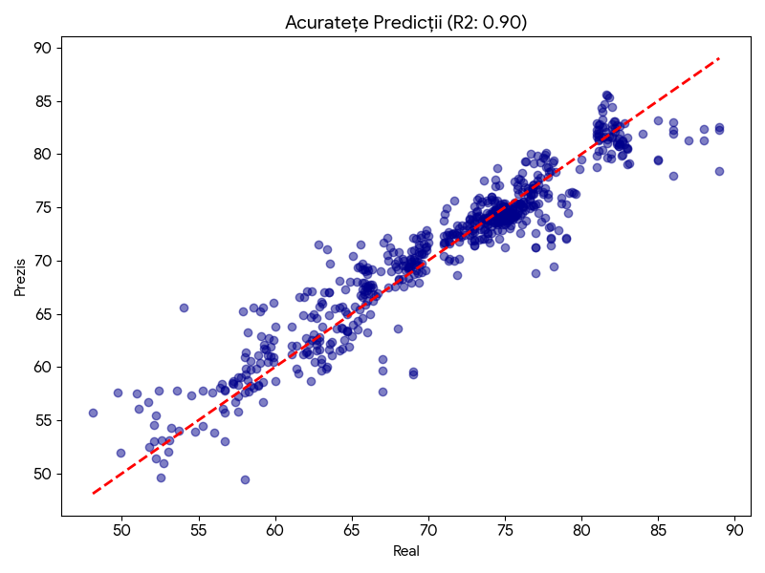
Performanta Modelului (Test Set)
Mean Absolute Error (MAE): 1.78 ani.
R-squared (R2): 0.899.
Semnificatie: Modelul explica peste 90% din variatia datelor.
Eroarea maxima a fost analizata individual pentru identificarea anomaliilor.

Slide 37
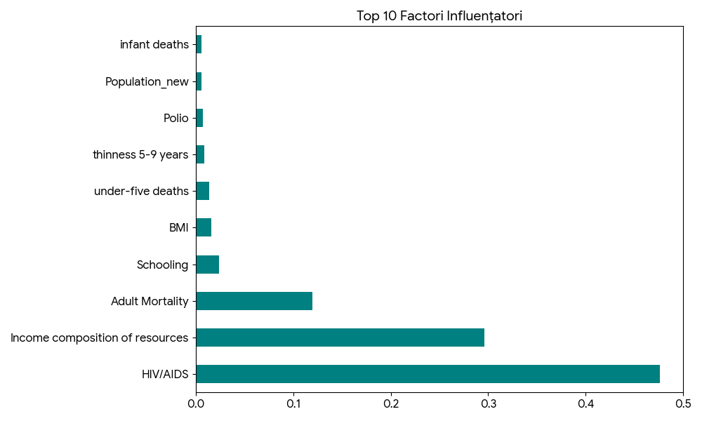
Analiza Factorilor de Influenta
HIV/AIDS: Impact major negativ asupra longevitatii.
Mortalitate Adulti: Corelatie directa puternica.
Resurse (Income composition): Indicator economic cheie.
Educatie (Schooling): Factor social determinant.

Slide 38
Concluzii si Recomandari
Modelul este extrem de robust pe date noi.
Indicatorii de sanatate (HIV, mortalitate) sunt mai predictivi decât cei economici in anumite regiuni.
HIV/AIDS: Impact major negativ asupra longevitatii.
Mortalitate Adulti: Corelatie directa puternica.
Resurse (Income composition): Indicator economic cheie.
Educatie (Schooling): Factor social determinant.
Curatarea riguroasa a datelor a fost esentiala pentru succesul algoritmului.
Rezultate predictive
MAE: 1.48 years
RMSE: 2.17 years
R2: 0.925
Adjusted R2: 0.923
Median AE: 0.97 years
Within ±1 year: 51.5%
Within ±2 years: 76.8%
Max Error (abs): 9.89 years
Country: Portugal | Year: 2014
Actual: 89.00 | Predicted: 79.11 | Signed error: -9.89

